Slide 1
Chapter 5
Chapters
1. Introduction
2. Graphs
3. Descriptive statistics
4. Basic probability
5. Discrete distributions
6. Continuous distributions
7. Central limit theorem
8. Estimation
9. Hypothesis testing
10. Two-sample tests
13. Linear regression
14. Multivariate regression
Important Discrete Distributions

Slide 2
Simplest Discrete Distribution: Bernoulli
Bernoulli is a single experiment that must result in one of two mutually exclusive and exhaustive outcomes.
Outcomes are usually called “Success” and “Failure”
P(success) = π, P(failure) = (1-π)
Need to know, what is “success”, and what the probability of “success” is.
Examples:
toss a coin-heads or tails
Select a product, defective or not
select a person, employed or not
select a shopper, purchase or not
select an investment, profit or not

Slide 3
Binomial Experiment…
Binomial experiments have the following properties:
Fixed number of trials, represented as n.
Each trial has two possible outcomes, a “success” and a “failure”, which are mutually exclusive and collectively exhaustive.
P(success)=p (and thus: P(failure)=1–p), for all trials.
The trials are independent, which means that the outcome of one trial does not affect the outcomes of any other trials.

Slide 4
Success and Failure…
…are just labels for a binomial experiment, there is no value judgment implied.
For example a coin flip will result in either heads or tails.
If we define “heads” as success then necessarily “tails” is considered a failure (inasmuch as we attempting to have the coin lands heads up).
Other binomial experiment notions:
An election candidate wins or loses
An employee is male or female

Slide 5
(I) Binomial Distribution

Slide 6
Binomial Distribution…
The binomial distribution is the probability distribution that results from doing a binomial experiment.
The binomial random variable is defined as the number of successes in the n independent Bernoulli trials.
The random variable, X, is the number of successes in a fixed number of trials, and is, thus, discrete.
Three important items for the Binomial distribution:
Sample Space of X
Number of trials (n)
P(success) for each trial, π

Slide 7
Binomial Random Variable…
E.g. flip a fair coin 10 times…
1) Fixed number of trials ✓ n=10
2) Each trial has two possible outcomes ✓ {heads (success), tails (failure)}
3) P(success)= 0.50; P(failure)=1–0.50 = 0.50 ✓
4) The trials are independent ✓ (i.e. the outcome of heads on the first flip will have no impact on subsequent coin flips).
Hence flipping a coin ten times is a binomial experiment since all conditions were met.
The probability associated with each value:
for x=0, 1, 2, …, n

Slide 8
Example 7.2…
Developing a Probability Distribution…
Sales Call 1
Sales Call 2
Sales Call 3
(.2)(.2)(.8)= .032
P(S)=.2
S S S
S S S^{C}
S S^{C} S
S S^{C} S^{C}
S^{C} S S
S^{C} S S^{C}
S^{C} S^{C} S
S^{C} S^{C} S^{C}
P(S)=.2
X P(x)
0.2³ = 0.008
3*0.032=0.096
3*0.128=0.384
0 0.8³ = 0.512
P(S^{C})=.8
P(S)=.2
P(S)=.2
P(S^{C})=.8
P(S^{C})=.8
P(S)=.2
P(S^{C})=.8
P(S)=.2
P(S^{C})=.8
P(S)=.2
P(S^{C})=.8
P(S^{C})=.8
P(X=2) is illustrated here…

Slide 9
Factorial Notation
5! = 1 * 2 * 3 * 4 * 5= 120
3! = 1 * 2 * 3 = 6
1! = 1
0! = 1

Slide 10
Example 7.2…
Example Sales Calls: n=3, p=0.2

Slide 11
Binomial Probabilities in Excel
=BINOM.DIST(x,n,,0/1)
x = the value of the random variable you are interested in
n = the number of trials, or the sample size
= the probability of success
0/1 = whether you are calculating the probability of a single x value or the cumulative probability from 0 up to x.

Slide 12
Pat Statsdud…
Pat Statsdud is a (not good) student taking a statistics course. Pat’s exam strategy is to rely on luck for the next quiz.
The quiz consists of 10 multiple-choice questions. Each question has five possible answers, only one of which is correct.
Pat plans to guess the answer to each question.
Is this a binomial experiment? Check the conditions:
✓ There is a fixed finite number of trials (n=10).
✓ An answer can be either correct or incorrect.
✓ The probability of a correct answer (P(success)=.20) does not change from question to question.
✓ Each answer is independent of the others.

Slide 13
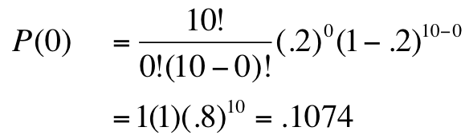
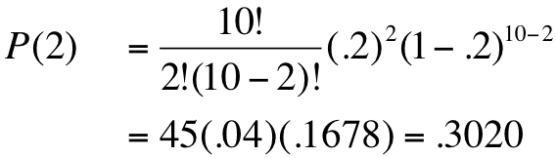
Pat Statsdud…
n=10, and P(success) = .20
What is the probability that Pat gets no answers correct?
I.e. # success, x, = 0; hence we want to know P(x=0)
What is the probability that Pat gets two answers correct? i.e. # success, x, = 2; hence we want to know P(x=2)
Pat has about an 11% chance of getting no answers correct using the guessing strategy.
Pat has about a 30% chance of getting exactly two answers correct using the guessing strategy.

Slide 14
Cumulative Probability
To answer the question: “Find the probability that Pat fails the quiz” requires a cumulative probability, that is, P(X ≤ x).
If a grade on the quiz is less than 50% (i.e. 5 questions out of 10), that’s considered a failed quiz.
Thus, we want to know what is: P(X ≤ 4).
P(X ≤ 4) = P(0) + P(1) + P(2) + P(3) + P(4)
Using the binomial formula to calculate:
P(0) = .1074, P(1) = .2684 , P(2) = .3020 ,P(3) = .2013, and P(4) = .0881
We have P(X ≤ 4) = .1074 + .2684 + … + .0881 = .9672
Use: = binom.dist(4,10,0.2,1) = 0.9672 for cumulative probabilities
Thus, it’s about 97% probable that Pat will fail the test using the luck strategy and guessing at answers…

Slide 15
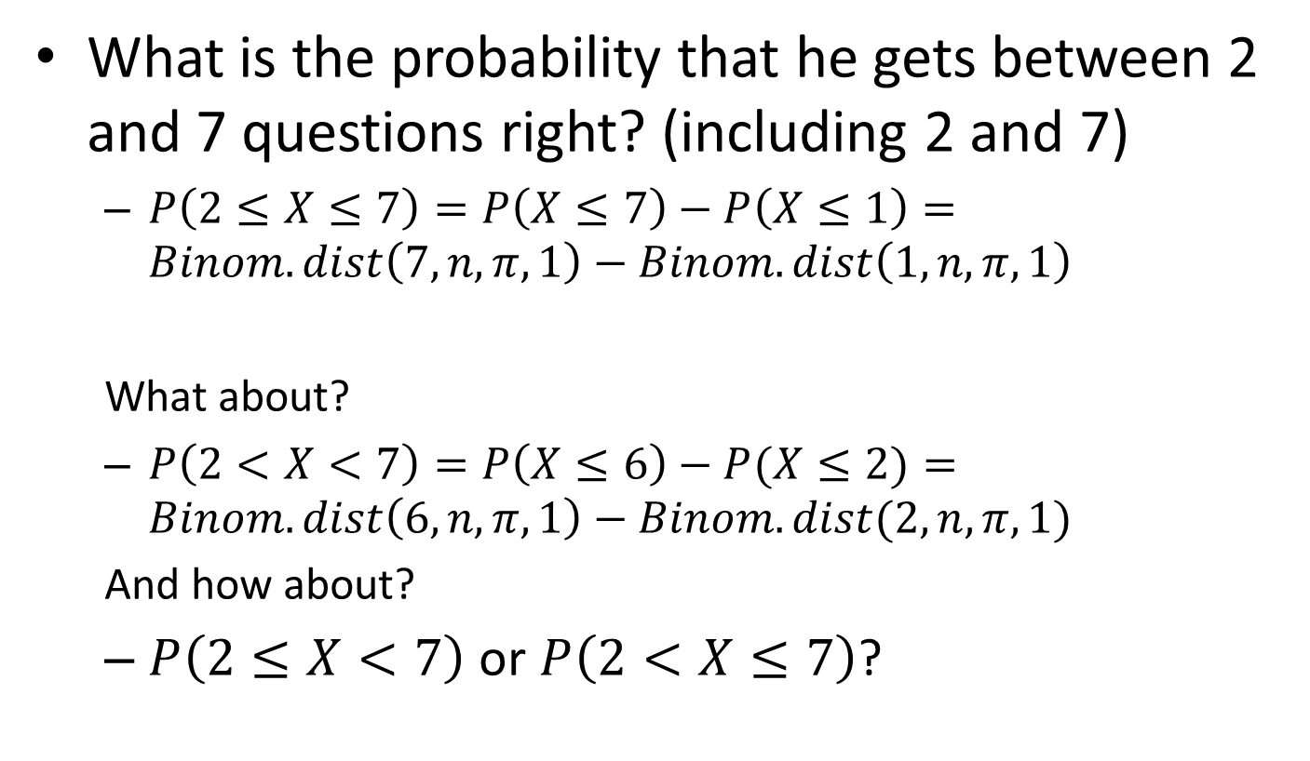
Pat Statsdud…
What is the probability that he gets between 2 and 7 questions right? (including 2 and 7)
$P\left(2≤X≤7\right)=P\left(X≤7\right)−P\left(X≤1\right)=Binom.dist\left(7,n,π,1\right)−Binom.dist\left(1,n,π,1\right)$
What about?
$P\left(2<X<7\right)=P\left(X≤6\right)−P(X≤2)=Binom.dist\left(6,n,π,1\right)−Binom.dist(2,n,π,1)$
And how about?
$P\left(2≤X<7\right)$ or $P\left(2<X≤7\right)$?

Slide 16
Binomial Graphs
Binomials are well-suited to histograms.
Each value of X has a column above it.
The column’s height is P(X).
Columns are one unit wide, so the AREA of the column is P(X), too.
Two factors influence the look of a Binomial graph:
π < 0.5, Binomial is right skewed, π > 0.5, Binomial is left skewed, and π = 0.5, Binomial is symmetric
When n is small, the Binomial is determined by π. However, as n becomes large, the Binomial becomes more and more symmetric, regardless of π.

Slide 17
Binomial Distribution as a Graph
To calculate probabilities use:
P(X=x) = binom.dist(x,n,pi,0)
To graph use: Insert -> ScatterPlot -> change chart type to bars.
X | P(X=x) | n | 10
0 | 10.73742% | pi | 0.2
1 | 26.84355%
2 | 30.19899%
3 | 20.13266%
4 | 8.80804%
5 | 2.64241%
6 | 0.55050%
7 | 0.07864%
8 | 0.00737%
9 | 0.00041%
10 | 0.00001%
 | 100.00000%

Slide 18
Examples

Slide 19
Expected values
Bernoulli:
A one-parameter distribution: π completely defines any Bernoulli.
E(X)=π, V(X)=π*(1-π)
Binomial:
The Binomial is the sum of n Bernoullis.
It is defined completely by n and π.
E(x) =nπ, V(X) =nπ(1-π)

Slide 20
Example
A councilman claims that 30% of residents support a tax increase on alcoholic beverages. A polling agent is going to sample 50 residents. According to the councilman,
1. How many X values are in the sample space for X?
2. What shape will a graph of this variable have?
3. How many voters are expected to be in favor in this sample?
4. What will be the variance of total number of voters in favor of the tax increase.

Slide 21
More Binomial Examples
30% of wells drilled are deemed favorable to strike oil.
A company has found 5 sites with favorable conditions, that are widely separated geographically, and decides to drill at each site. To cover their costs, the company must have at least two strikes.
Select 10 manufactured items, defective or not, Manufacturer claims 2% are defective.
Select 100 people, unemployed or not, unemployment rate is 15%.
Contact 300 people, reply or not, usually 5% of people reply.
Sample 60 purchasers of contact lenses after one year, still wearing or not, 25% of people stop wearing lenses in one year

